Slide 1
Getting to grips with the Core Bioinformatics Resources

Slide 2
Overview
Who we are and the team organization.
Sequencing lifecycle at NYUAD.
MSIO.
GURU.
JIRA.
NASQAR
BioSAILs.
The GENCORE software modules.
Data policies and SOPs.
The HPC front-end interface.

Slide 3
The Team
Kristin C Gunsalus - Director of Bioinformatics NYUAD CGSB
Nizar Drou - Bioinformatics Lead Developer
Muhammad Arshad - Bioinformatics Data Analyst
Jayaram Radhakrishnan - Bioinformatics Infrastructure Engineer
Giuseppe A Saldi - Data Computational Scientist
Nabil Rahiman - Bioinformatics Full Stack Developer

Slide 4

Muhammad Arshad
Bioinformatics Data Analyst
Core Bioinformatics, CGSB

Slide 5
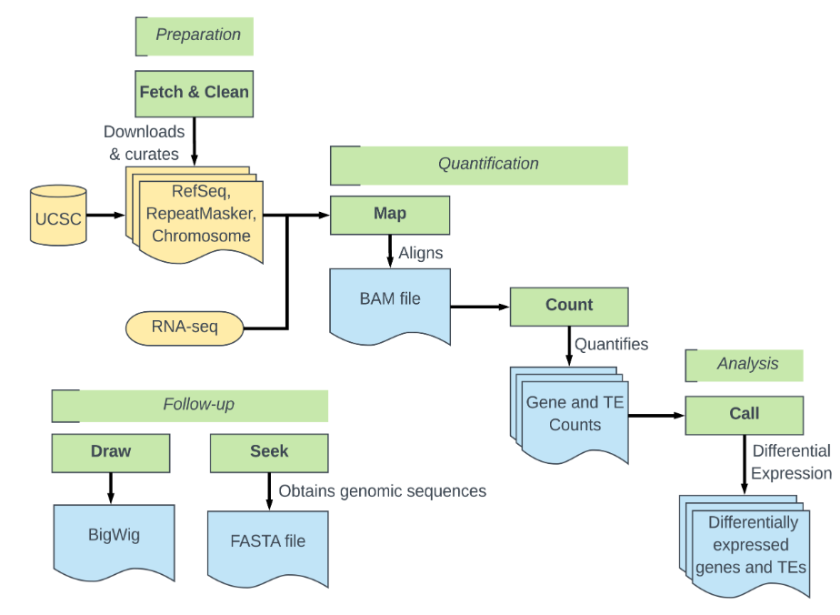

Transposable Element (TE) detection from RNAseq datasets
Like other TE expression software, SQuIRE
quantifies expression at the subfamily level and
performs differential expression analyses on TEs
and genes
Unlike past approaches, however, SQuIRE
quantifies TE expression at the locus level
Locus-specific analysis, attainable with SQuIRE, is essential to get a true picture of the TE transcriptome
SQuIRE provides a suite of tools to ensure the pipeline is user friendly, reproducible, and broadly applicable
Externally
generated

Slide 6
Metagenomics
Raw fastq reads
Assembly-based
Reference-based
Clean Metagenomic reads
Assembly
Kraken 2
MetaPhlAn 4
HUMAnN 3
MetaBAT2
MaxBin2
CONCOCT
Binning
Bin Refinement
Bracken
Merge tables
Join/norm tables
Bin
re-assembly
Taxonomic classification
Functional classification
DRAM
GTDB-tk
FastTree
BAKTA
Functional profiling
Bin taxonomy
Phylogenetic tree
Gene annotation
kronagram, abundance bars, pathways, heatmap

Slide 7
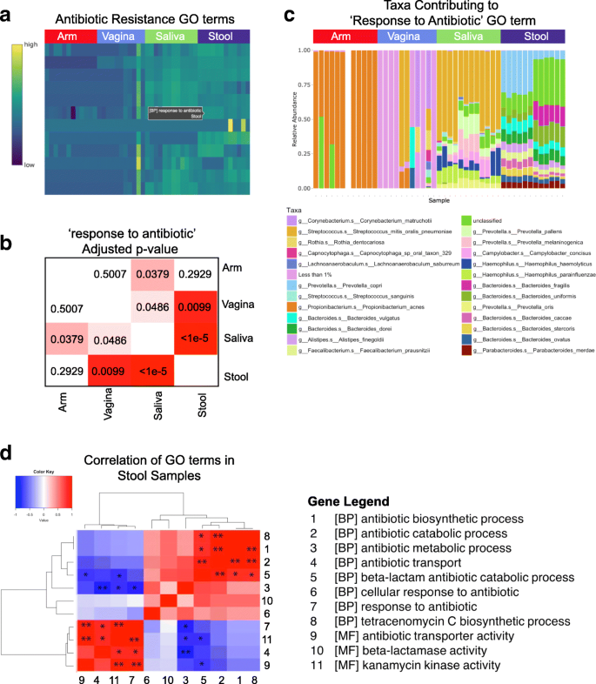
Other analyses ...
Antimicrobial resistant (AMR)
DNA methylation
Small RNA / microRNA
DEGs, KEGG/GO, volcano plots, heatmaps, etc.
from bulk RNA-seq data
Digital normalization

Slide 8
Jayaram Radhakrishnan Bioinformatics Infrastructure Engineer NYUAD CGSB

Slide 9
Accountabilities
Genomic Sequencing Automated Platform
Build and manage Apache Airflow tool to automate sequencing runs.
LIMS System
LIMS is based on open source MISO software.
Data Warehousing
Build data warehousing setup to maintain PHRC-g42 data.
Software Assistance
Assistance for software install requests in HPC.
Data Transfer
Assistance for data transfer with external collaborators over SFTP, globus, aspera etc..
Cutting Edge Technologies
Building, managing, maintaining the CGSB infrastructure management, software build using Devops engineering practices.

Slide 10
KEY SKILLS
Cloud Management
AWS & Azure
Containerization technology
Docker, Singularity
Kubernetes
Programming Languages:
Bash/Shell
Python
Past Experience:
Systems Engineer in Halian Dubai
Technical Lead in Nokia Chennai, India.

Slide 11
Nabil Rahiman
Bioinformatics Full Stack Developer

Slide 12
Current Responsibilities
High-throughput chemical and functional genomic screening
Develop, maintain, and manage a database framework for data archival and analysis of genomics screening data.
Statistical analysis and reporting.
Developing R shiny based app for
Epigenetics
Metagenomics
single cell and bulk analysis
Bioinformatics:
Single and Bulk analysis standard pipeline(GSVA, GSEA, Seurat, deseq2,ProjecTILs)
MIMI (Molecular Isotope Mass Identifier):
A command line tool to identify metabolites present in biological metabolites from mass spectrometry data

Slide 13
Technical Expertise
Programming Languages:
R/R Shiny
Python
C/C++/Java
Assembly Programming(x86 and Arm Architecture)
System Programming
Full Stack Development:
React/Angular
MYSQL
Additional Skills:
Proficiency in Machine Learning techniques
Past Experience:
Computer Science Instructor at NYU AD( Supported almost all computer science courses)
System Software Developer in Bangalore, India.

Slide 14
Giuseppe SALDI can help you with data analysis
Single Cell Seq
Integration
Scripting

Slide 15
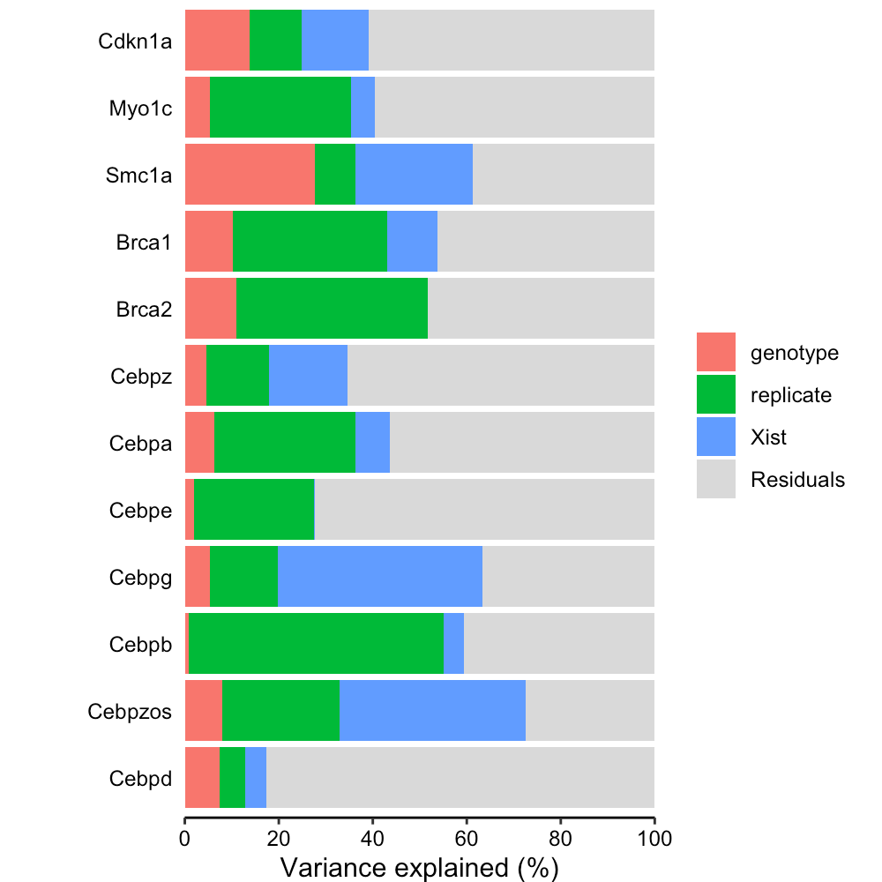
3 types of Single cell analysis run at the core
Single Cell Seq
Integration
Scripting
QC
Clustering,
Cell identification
Trajectories
Variance Partition

Slide 16
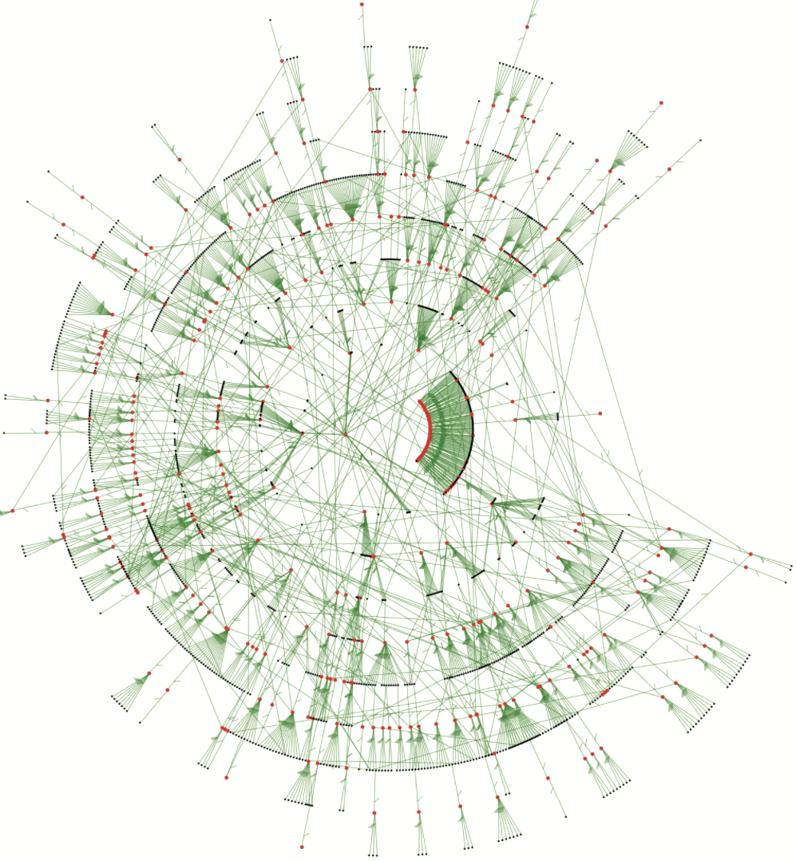
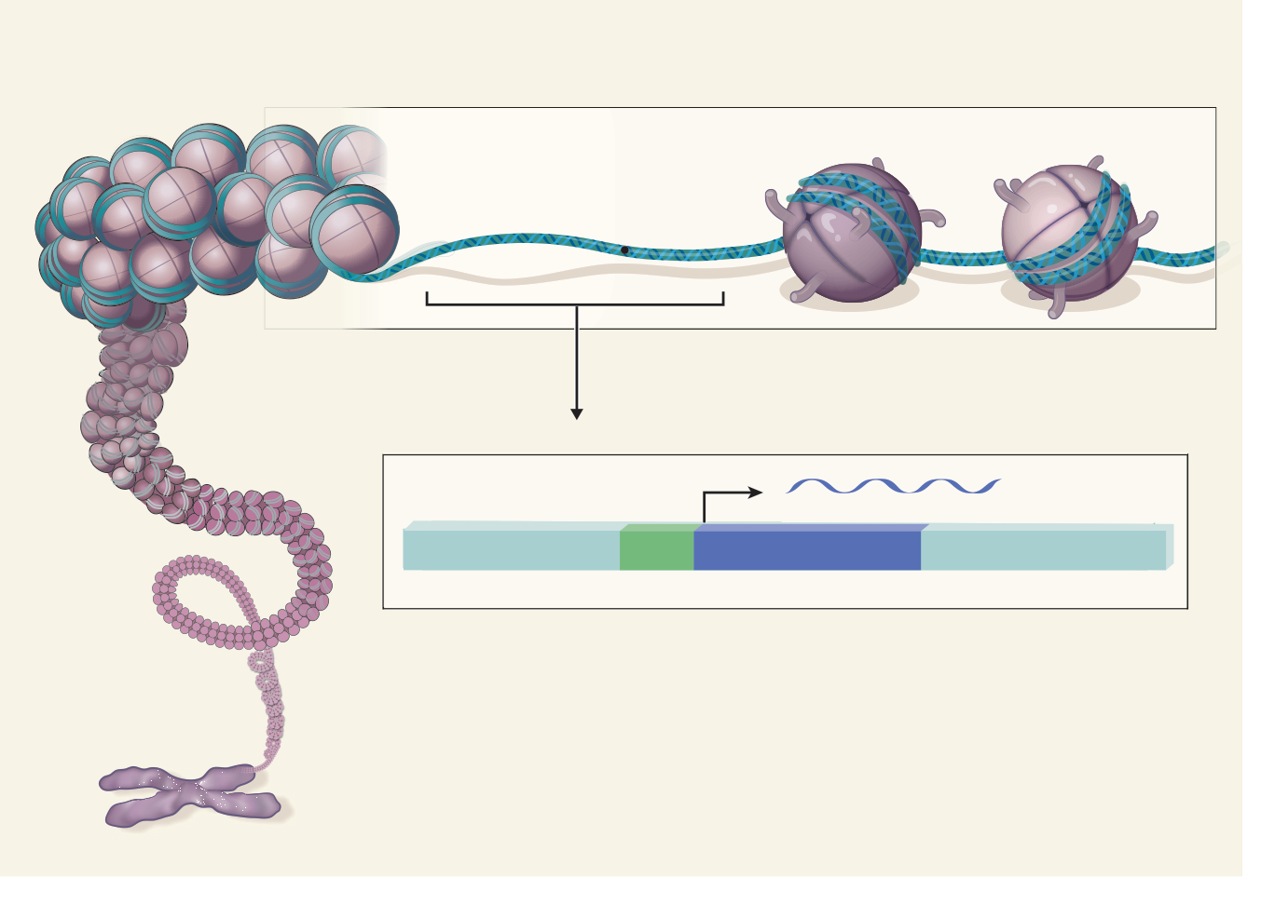
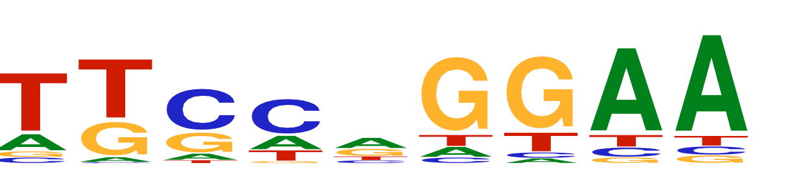

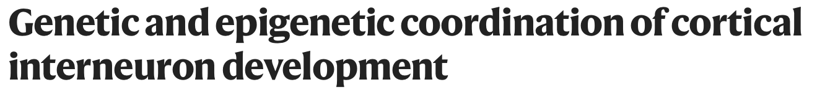
Gene regulatory network integration
Single Cell Seq
Integration
Scripting
G
G
G
ATACSeq
TF
G
ChIPSeq
scRNASeq
TF
TF
TF
TF
G
G
G

Slide 17
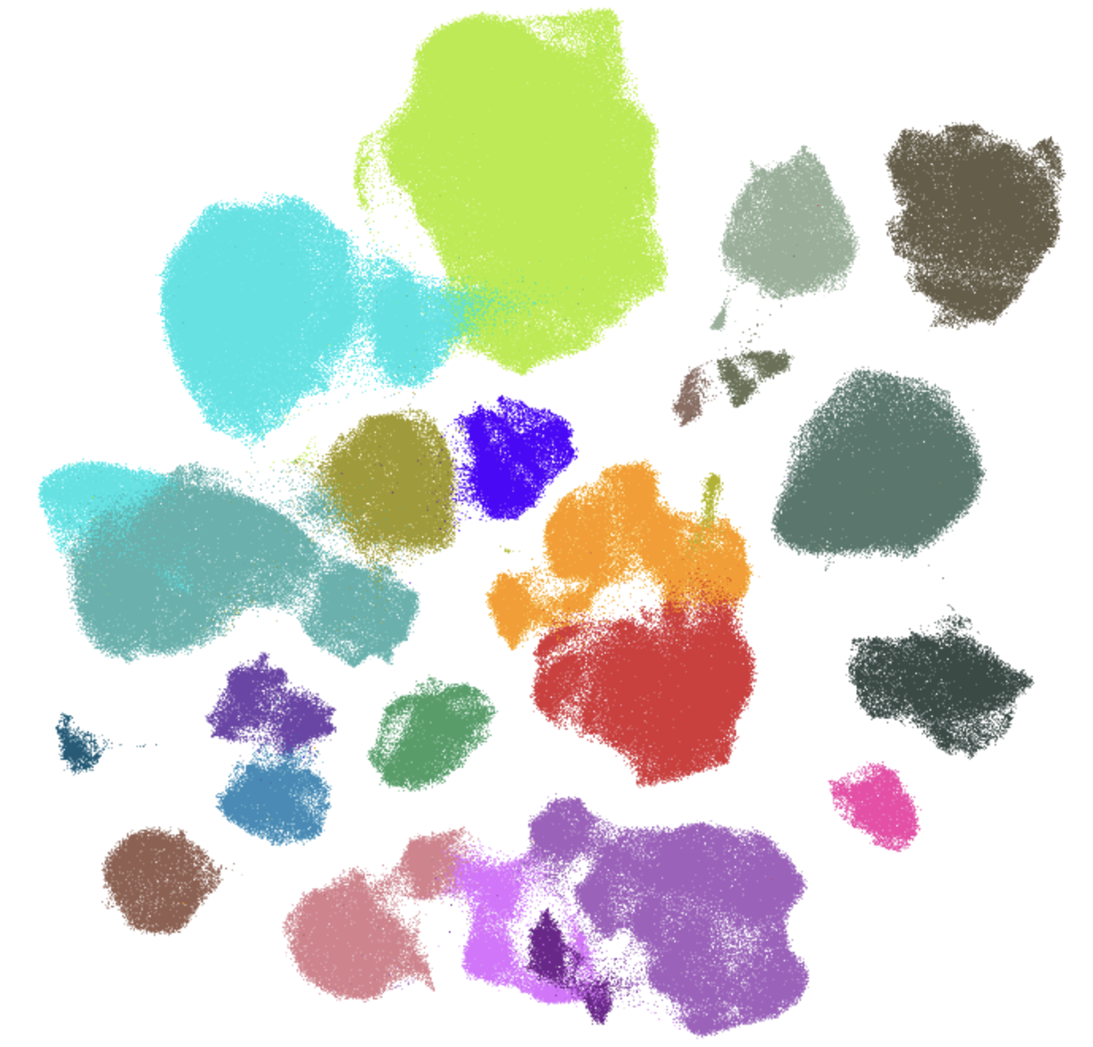
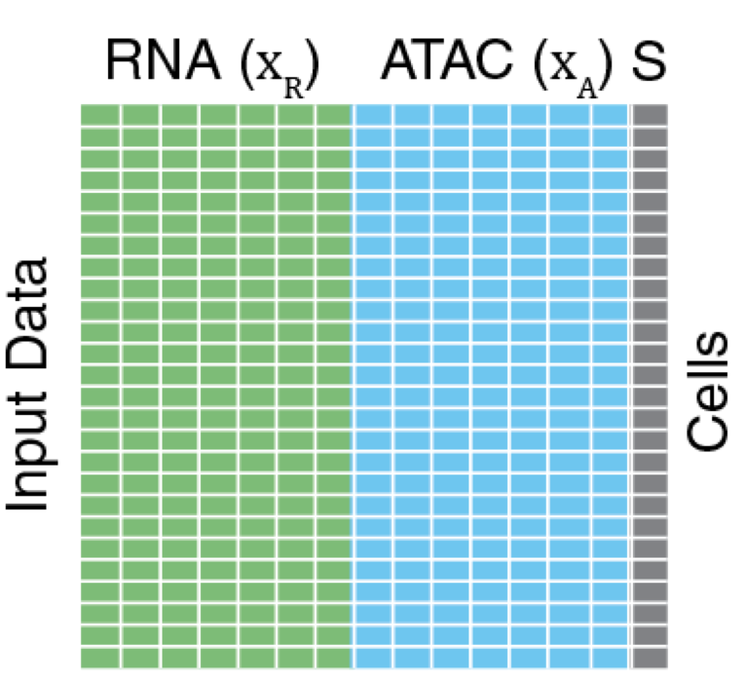

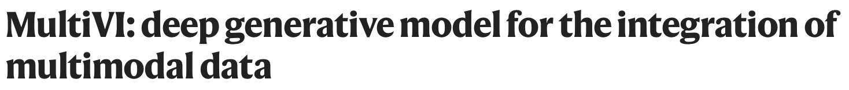
Multiomic integration using GPU
Single Cell Seq
Integration
Scripting
RNA
ATAC
Integrate
Transfer Label

Slide 18

Data manipulation
Single Cell Seq
Integration
Scripting

Slide 19
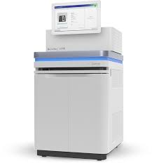

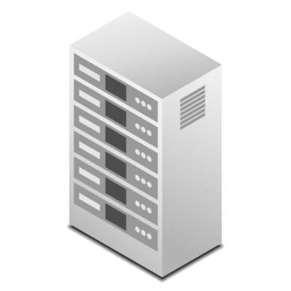

Sequencing Lifecycle at NYUAD
Sequencing
MISO
Sequencing instruments write directly
To the HPC cluster using the sample
Information provided by MISO.
GURU
Sample information and sequencing
run setup is entered in the LIMS by users
or sequencing team members.
GURU gathers the run info from
MISO, copies the run folder to
another location, demultiplexes,
runs QC/QT, archives the run, updates
The relevant JIRA ticket, sends progress
emails.
HPC
JIRA
BioSAILs
JIRA documents details about the run
including the folder path, the end users,
any special considerations (such as problematic
runs).
The run folder is written in a protected read
Only location on the cluster. Folders are arranged
on a per instrument basis.
BioSAILs is initiated by GURU and executes
the appropriate workflow.

Slide 20
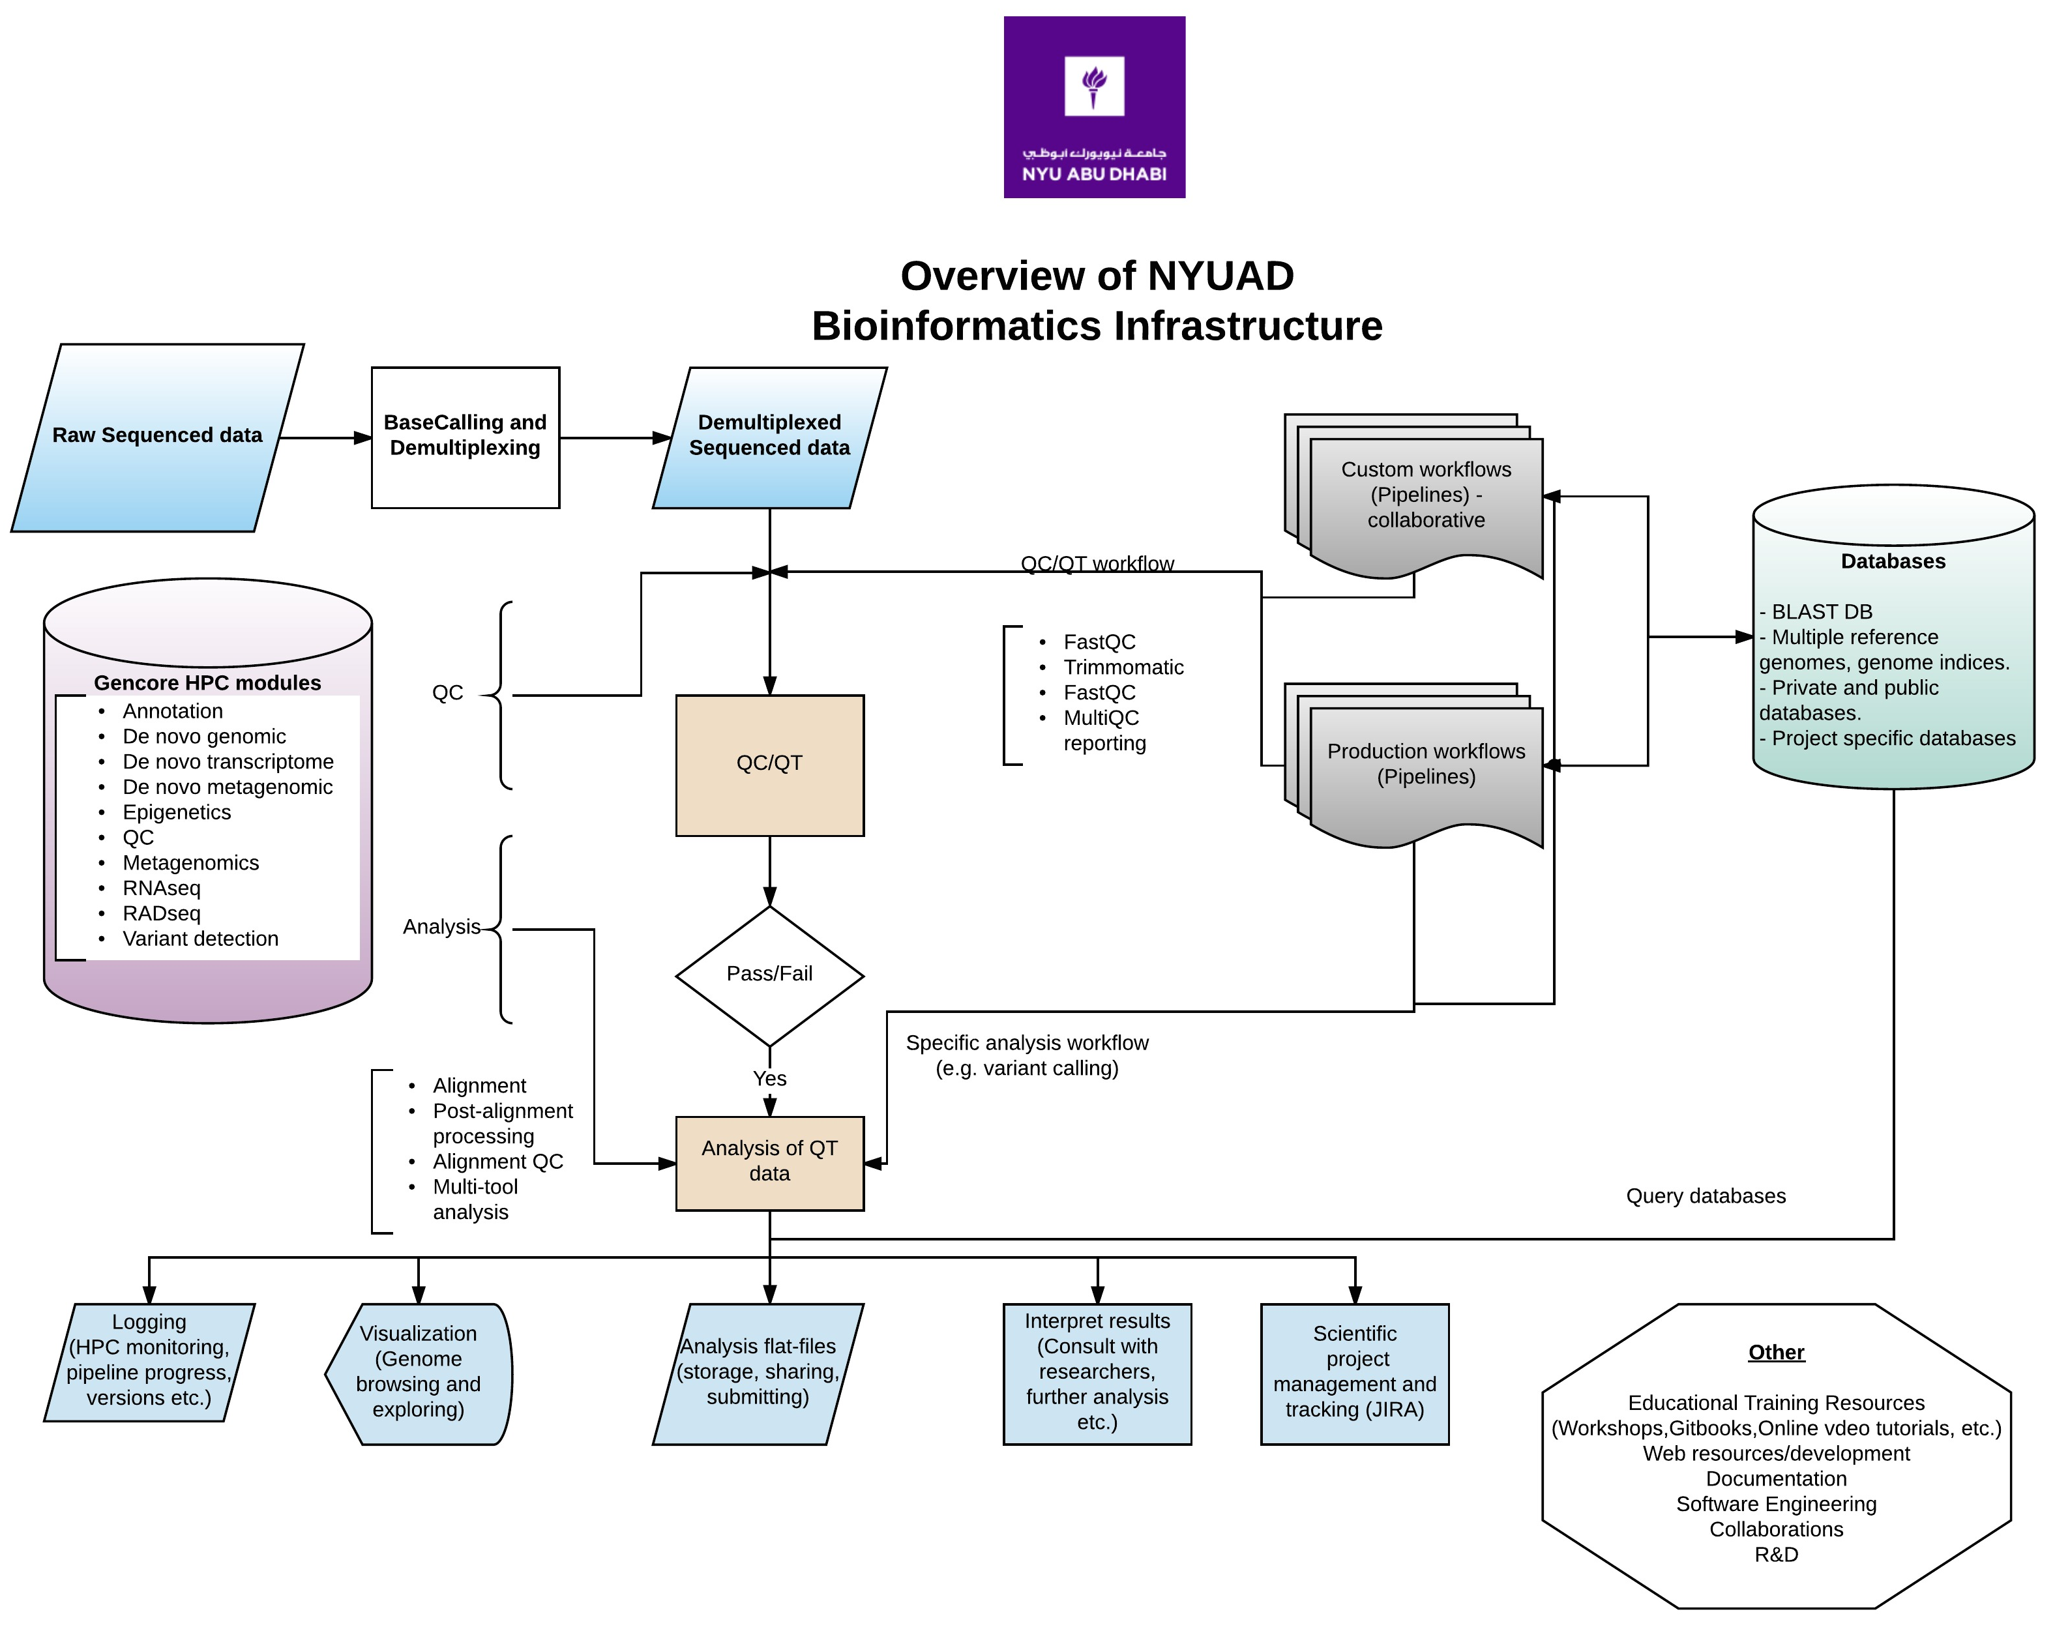
Notes:
Pipelines/workflows delivered through a bespoke in-house developed software (BioSAILs).
Multi-level QC at each stage of the data life cycle.
Extensive logging and documentation relating to the analysis.
Onsite reference datasets (including indices for software analysis).
Project management and tracking through JIRA.
Front end interfaces for data exploration and visualization (R shiny front end for RNAseq analysis, genome browsers), with some being public facing resources.
Software managed and deployed by the core bioinformatics (using conda/bioconda, easybuild).
Development and delivery of bioinformatics seminars/workshops/tutorials, for internal and external participants.

Slide 21
The LIMS
Our LIMS is based on the open source MISO software https://github.com/miso-lims/miso-lims
Used to catalogue sequencing samples and submit them for sequencing.
Available at https://miso.abudhabi.nyu.edu/
Fill out this form to request an account.
Quick video tutorial available here.
The NYUAD MISO instance is hosted on a stad-alone server.

Slide 22
GURU
Genomics seqUencing Run aUtomation – GURU.
Developed in-house for the automation of sequencing run processing.
Handles data migration and archiving, demultiplexing, WF submission and monitoring, reporting to JIRA, and emailing end-users.
The next iteration will allow users to tag samples, select appropriate downstream analysis WFs, and edit them if necessary, and submit them.
A standard REST API means it is extensible.

Slide 23
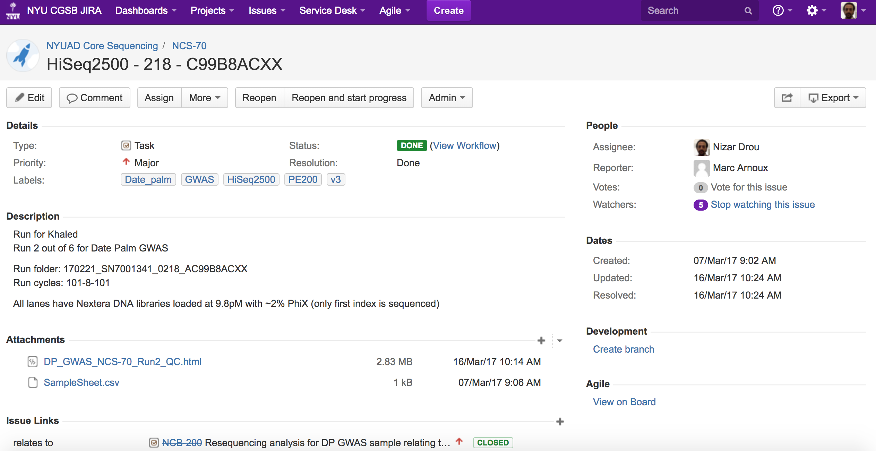
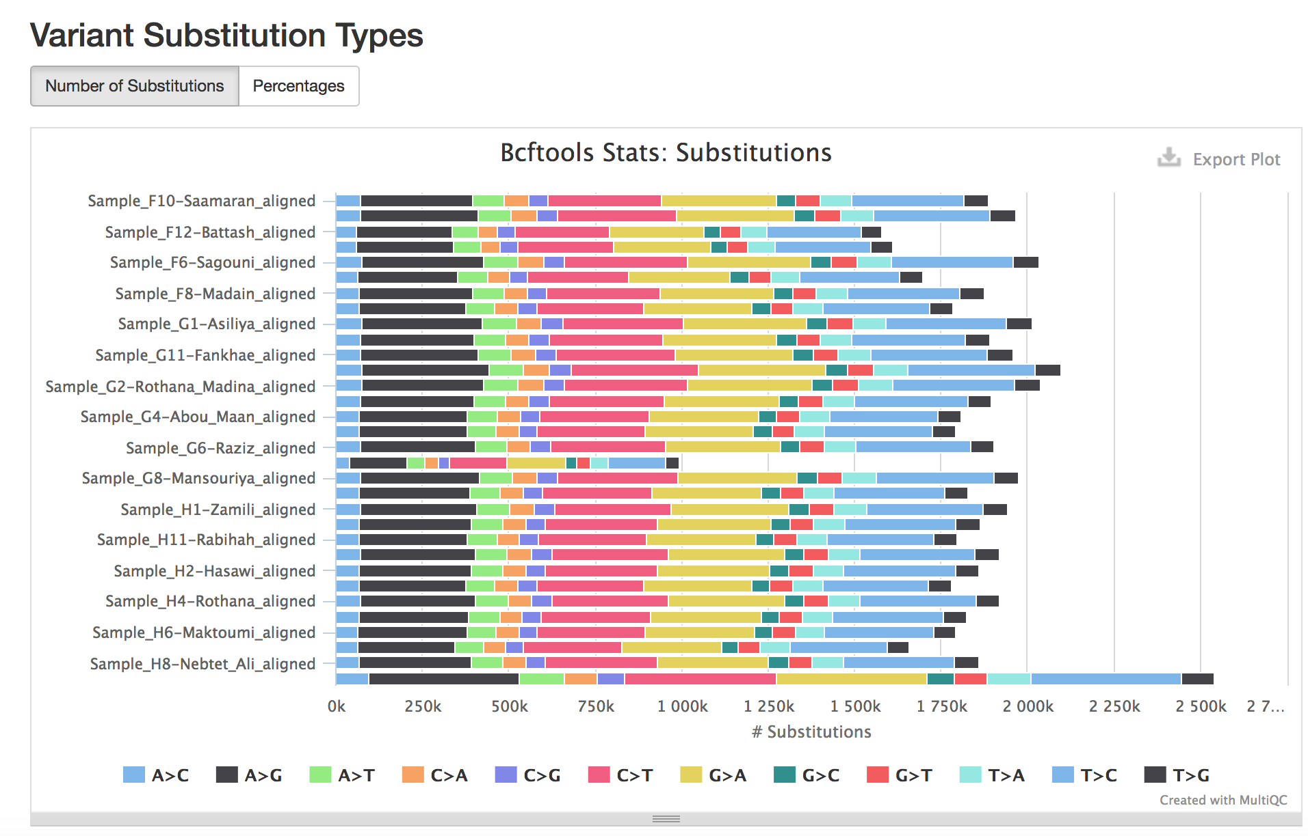
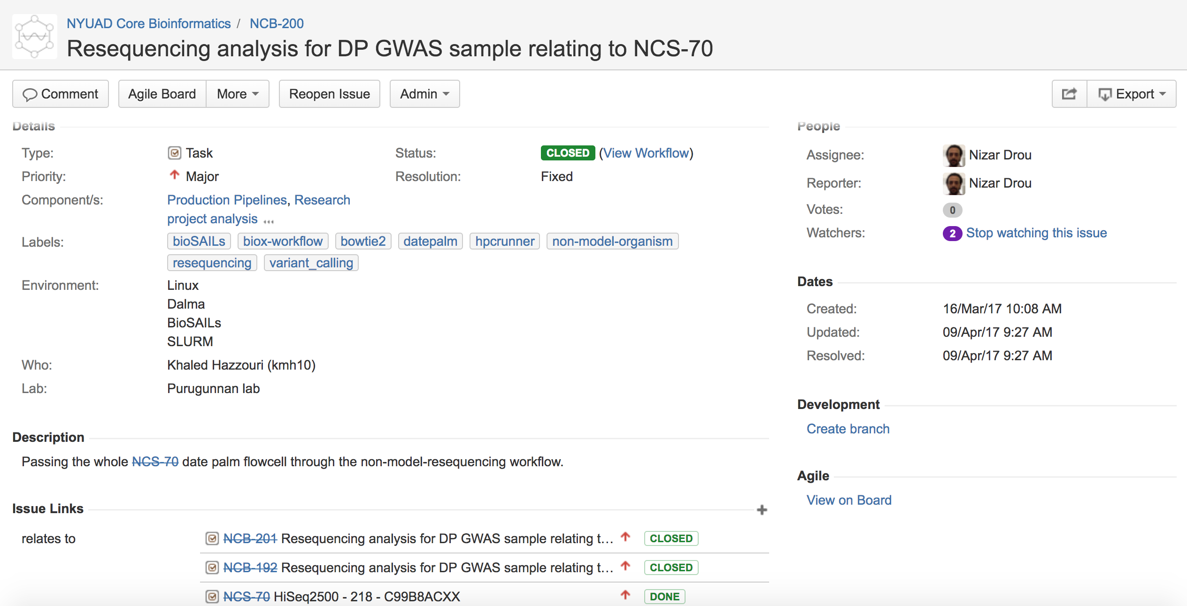
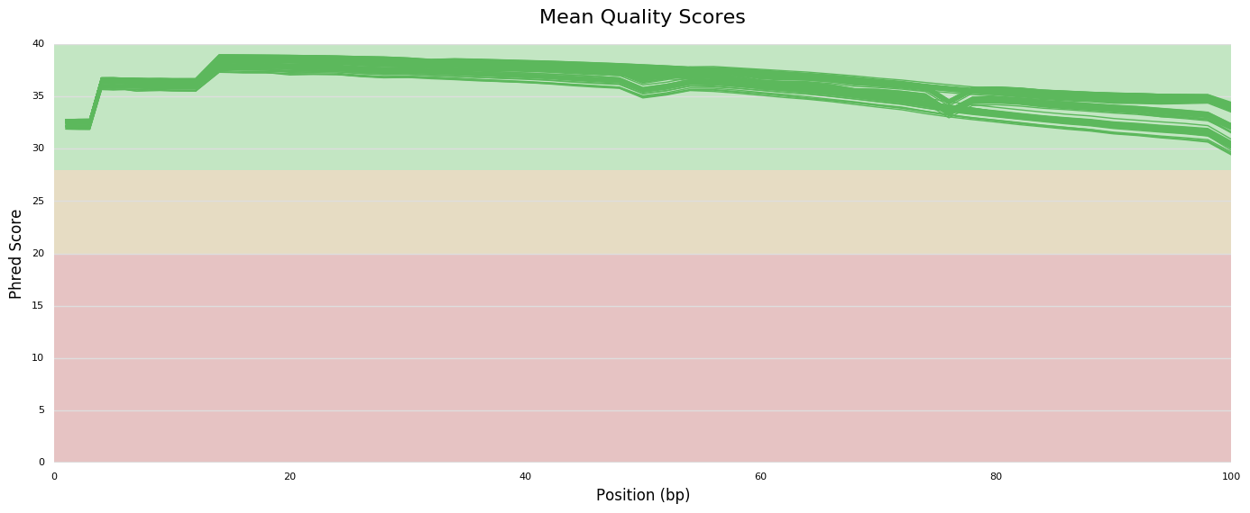
Scientific project management - JIRA
Notes:
Multiple projects means that we need to keep track of analysis, sequencing runs, and determine potential issues early on.
Make SOP definition easier.
Is a stepping stone for starting new collaborative work.
Easy to manage across multiple locations.
Makes the process of tracking projects over time easier.
Allows for integration with other versioning systems such as github.
Other solutions out there, but JIRA seems to work well.

Slide 24
NASQAR
NASQAR stands for Nucleic Acid SeQuence Analysis Resource.
Front-end web-based platform for high throughput sequencing data analysis and visualization.
Built on R and Rshiny.
NASQAR 2.0 will cover additional domains/apps (RNAseq, Sequencing data QC, Metagenomics, Epigenetics, WGS/WES/Panels).
Can be ran on a public website, deployed locally, or on the HPC.
http://nasqar2.abudhabi.nyu.edu/
https://github.com/NYUAD-Core-Bioinformatics/Nasqar2

Slide 25
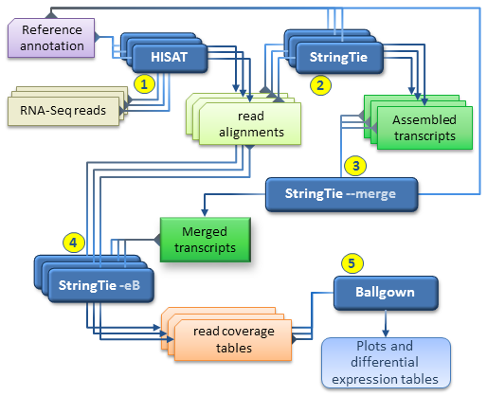
What are Workflow Management Systems
WMS are
A system that enables the automation and execution of a series of predefined tasks.
Capable of scaling and adapting as the tasks or the requirements change
Can abstract the backend process from the user
Uses an interface to define and execute the tasks.
In bioinformatics, WMS rely on some form of directed graph, where nodes usually are tasks, and edges represent data flow or dependencies.
Should also allow for monitoring and reporting of the executed workflows.
Ideally, should allow for an easy entry barrier to new and less experienced users.
Ideally, should be easily deployed on different architectures, and support multiple system setups.
There are a lot of WMS currently available and choosing the right one can be a challenge, but you should definitely pick one!
Differential expression analysis
http://ccb.jhu.edu/software/stringtie/index.shtml?t=manual

Slide 26
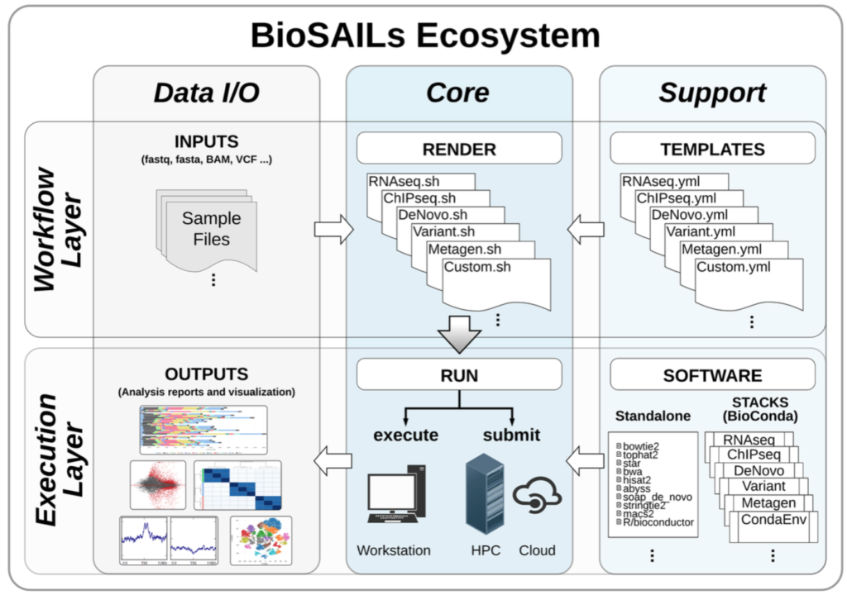
BioSAILs / What is it?
BioSAILs
Bioinformatics Standardized Analysis Information Layers
It comprises of 2 distinct layers,
Biox - Which is the analysis templating system.
HPCrunner - The workflow submission system.
Workflow are defined in YAML format.
Biox reads the YAML workflows and renders and executable script.
HPCrunner can then process the resulting shell script and submit on a workstation, HPC, or cloud infrastructure.

Slide 27
BioSAILs / Advantages
BioSAILs
Plain text based format for defining workflows make it easier to understand and create.
Versatile in where it can be deployed, standalone machine, HPC cluster, or a cloud environment.
Easy to install through Conda/Bioconda.
Does not use a Domain Specific Language (DSL).
Extensibility through the use of plugins and APIs, and can consume both YAML and JSON.
Reproducibility, logging, and reporting.
Web resources and support with rich documentation, howto guides, and interactive workflow editor.
NYU researchers can benefit from in-house support for a WMS that has been running in production for the last 4 years.
Multiple production level workflows already exist to cover, QC/QT, RNAseq, WGS/WES, de novo Genome/transcriptome, Epigenetic analysis, Metagenomics.
Notes:
- NextFlow and BigDataScript are each Domain Specific Languages (DSL). BioSAILs is more similar to SnakeMake and bcbio.
- The largest gain to reproducible research is having a clear and concise configuration template. And the whole analysis submission can be integrate in github for version control.
Logging is done per submission, per job, and per task with both a tabular terminal view and a programmatic JSON output. Exit codes, duration, stdout, stderr, and original commands are all logged.
BioX moves all the logic of finding files and organizing the workflow structure to the BioX libraries, giving the end user and any collaborators a format that is easy to read and parse.

Slide 28
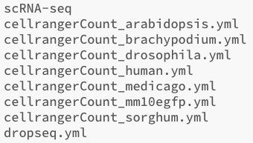
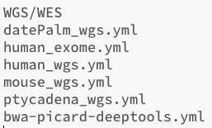
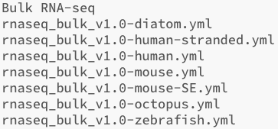
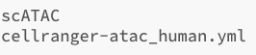
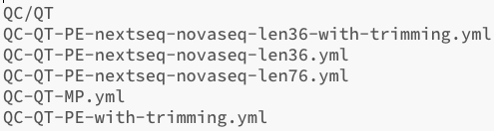
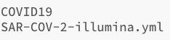
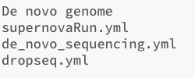
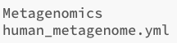
A whole collection of ready-made workflows
Over the years, we have compiled many workflows to perform various types of analysis. All of which are ready to use with minimal changes.
Notes:
The logic of your workflows remains the same whether processing 1 or 1000 samples. HPCRunner splits your workflow into efficient chunks, and lets the scheduler take care of the rest.
Executing hpcrunner with a SLURM, PBS, or SGE scheduler.

Slide 29
Bioinformatics Software on the HPC – GENCORE modules
We are responsible for deploying software stacks on Dalma, NOT the HPC team.
Two versions exist, gencore/1 and gencore/2.
Third option is for you to maintain and install your own software stack (e.g. conda / miniconda).
Only singularity is currently supported, no Docker.
We can also build software from source if they are not available through conda.
We also maintain a host of reference genomes and their indices at /scratch/Reference_genomes/Public/
gencore/1
Groups of relevant software deployed together as one module (e.g. variant_detection or de_novo_gencomic).
Great for just loading one module with all the software.
Difficult to maintain and update.
None searchable (at least not easily)
Will not be supported in the future but is still being used.
gencore/2
Software built as individual modules
Can be configured to act in a similar way to grouped software using BioSAILs.
Easy to install and deploy cluster-wide
Searchable using the module avail command.
Any software, any version that is available in bioconda can be installed and deployed.
module load gencore
module load gencore_variant_detection
module load all
module load gencore/2
module load samtools/1.9

Slide 30
Data policies and SOPs
The Core bioinformatics team has a large allocation of resources available on the HPC.
Sequencing data can only be read by the gencore users (not overwritten).
Data is staged on the $SCRATCH filesystem.
Sequencing and analysis folder locations are archived using an automated process daily.
Sharing of data with external collaborators needs to be submitted in writing.
We will always maintain all sequencing data including the WFs and parameters that generated the results (also analysis results..for now).
Dearchiving of data uses a dedicated folder structure and will be the end-users responsibility to ensure storage allocation.
We can upload your data to public repositories (e.g. SRA) but you will have to create an account and fill out any metadata requirements.
Remember, we don’t own your data, we just maintain it!

Slide 31
The HPC Front-end Interface
Accessible at https://ood.hpc.abudhabi.nyu.edu/pun/sys/dashboard
We collaborate with the NYUAD HPC team to deploy Bioinformatics software.
Useful for running Rstudio with large resources.
Useful for initiating IGV.
Accessible from within the “Interactive apps” tab.
Let us know if there is a particular app you want deployed.

